Slide 1
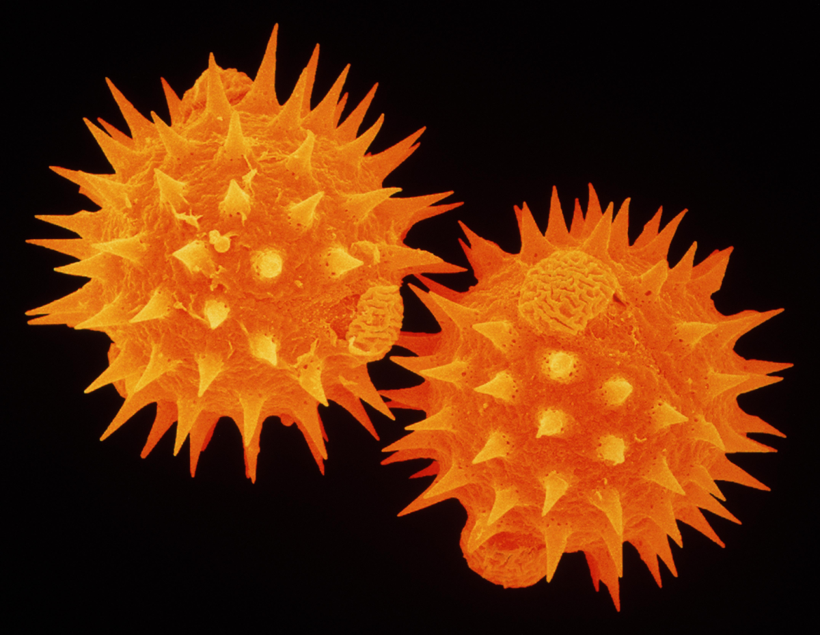
POLLEN MORPHOLOGY
Submitted by-
Kashmita Ojah
Assistant Professor
Department Of Botany
S.B.DEORAH COLLEGE

Slide 2
Contents
Introduction
Pollen Units
Polarity
Symmetry
Shape
Size
Apertures
Sporoderm Stratification
Exine ornamentation.

Slide 3
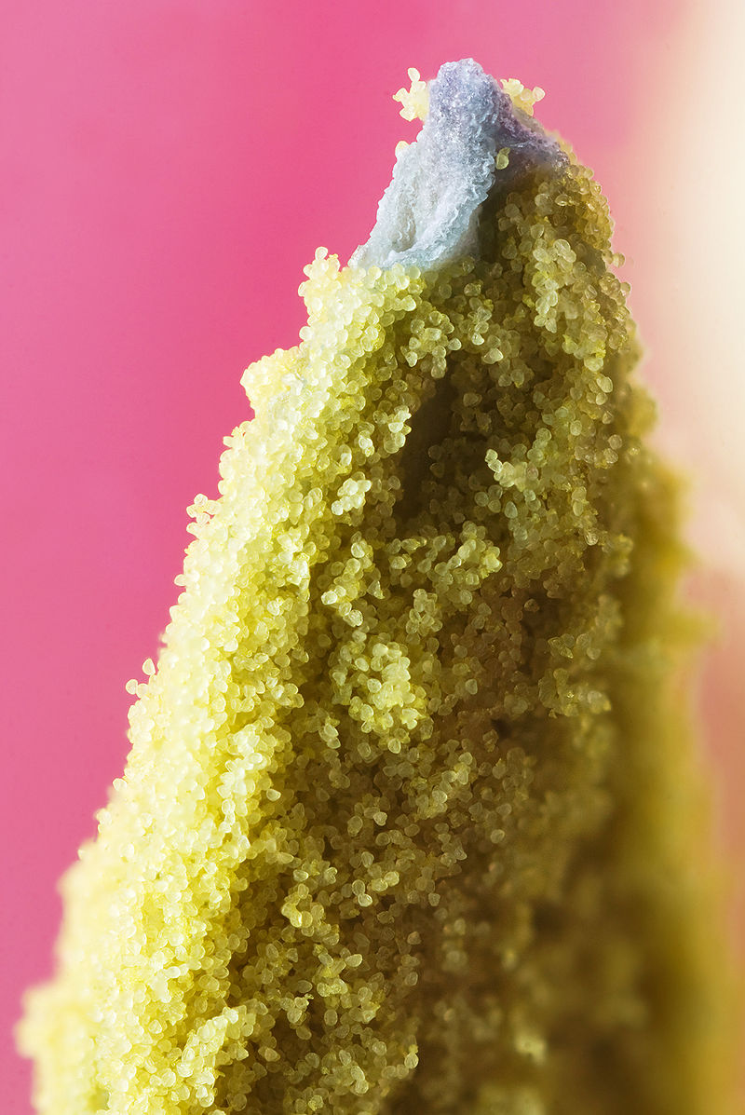
Introduction
The term Palynology was first introduced by Hyde and Williams in 1944.
The word is derived from Greek words Paluno means sprinkle and Pale means dust.
Pollen grains the male gametophyte of flowering plants.
Pollen is a fine powdery substance .
Consists o two layers-inner intine and the outer exine.

Slide 4
Pollen units
The pollen grains are produced within the anther of flower.
Pollen mother cells originating from sporogenous tissue of anther divide meiotically to form tetrad.
The pollen grains do not remain united at maturity,and are dissociated into different types viz.
Monad- dissociates into singly.
Dyads- pollen grains which are united in pairs and shed from the anthers as doubles.
Tetrads-four pollen grains are united to form tetrad. Based on their arrangement they may be categorised into-
1. Tetrahedral tetrad -they are arranged in two different planes, three in one plane and the other one lies over the other three.eg.Drymis (Winteraceae), Drosera etc

Slide 5
2.Tetragonal tetrad- all the pollen grains are arranged in one plane.eg. Typha latifolia, Hedycaria arborea, etc.
3.Rhomboidal tetrad- arranged in one plane forming rhomboidal shape.eg. Annona muricata (Annonaceae).
4.Deccusate tetrad- pair-wise the pollen grains are arranged in right angle to each other.eg. Magnolia grandiflora.
5. T-shaped tetrad- the first division of pollen mother cell is transverse to form a dyad. The upper or lower cell of the dyad undergoes a vertical or longitudinal division forming a T- shaped configration.eg. Aristolochia sp., Polyanthes sp.etc.
6.Linear tetrad- the first division is transverse to form dyad and again it divides transversely to form a linear tetrad.eg. Mimosa pudica.
7.Cryptotetrad- tetrads are formed without partition walls between four compartments, out of which one develops normally and other three obliterates.eg. Cyperaceae.

Slide 6
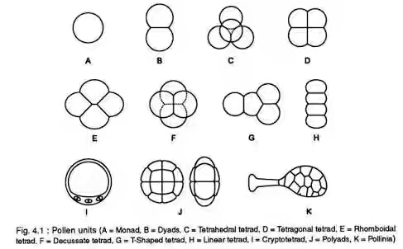
Polyads-In most of the Mimosaceae members each of the tetrad cells divides once or twice or more yielding a group of 8 to 64 cells which remains together at maturity and are held together in small units called polyads.eg. Acacia auriculiformis, Samania saman, etc.
Pollinia- In Orchidaceae and Asclepiadaceae, the whole contents of anther shed as one
Fig 1

Slide 7
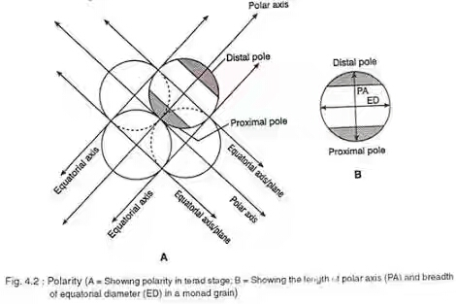
Polarity
Polarity is important in identification and description of pollen grains.
Polarity is determined at tetrad stage.
The part of the pollen nearest to the centre of the tetrad is the proximal pole and towards the opposite side it is distal pole.
Imaginary pole between proximal and distal pole of the grain is called Polar Axis(PA) which passes through the centre of spore to centre of tetrad.
Fig 2

Slide 8
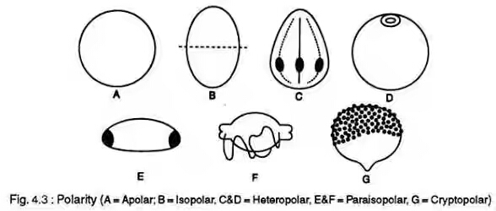
The plane perpendicular to PA through the middle of grain is the Equatorial Plane(ED).
The pollen grains may be either polar or apolar-
Apolar- poles and polar regions cannot be distinguised in individual spores after separation from tetrad.
Polar- pollen grains may be isopolar or heteropolar depending upon the demarcation between two equal and unequal polar faces.
In isopolar, poles are similar.
In heteropolar the two areas are dissimilar.
Fig 3

Slide 9
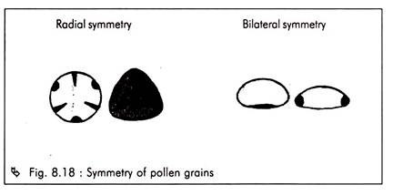
Symmetry
Pollen grains are symmetric or asymmetric.
The asymmetric grains are either fixiform or non- fixiform.They have no plane of symmetry and are rare.
The symmetric grains are either radiosymmetric or bilateral.
Fig 4

Slide 10
Shape
The shape of pollen grains usually varies from species to species.
This is useful in pollen identification.
However the shape may vary within one grain type or species.
G. Erdtman (1952) categorized eight shape classes based on the ratio of polar axis (PA) and equatorial diameter(ED).
PA/ED x 100
Various PA/ED ratios are divided into different shape classes- prolate , prolate – spheroidal , spheroidal , sub-prolate , perprolate ,oblate , oblate-spheroidal , sub- oblate, peroblate.

Slide 11
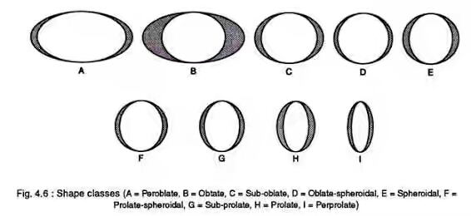
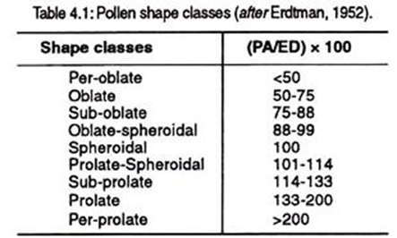
Fig 5

Slide 12
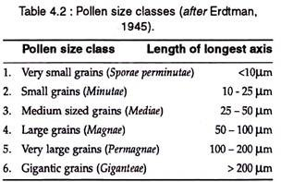
Size
Pollens grains show a great variety in their sizes.
Smallest pollen grains is noted in Myosotis palustris( 5 x 2.4 micron) and in some members of Boraginaceae.
Largest pollen grains are observed in Cucurbitaceae, Nyctaginaceae etc.
Erdtman(1945) classified different pollen classes based on their size expressed.

Slide 13
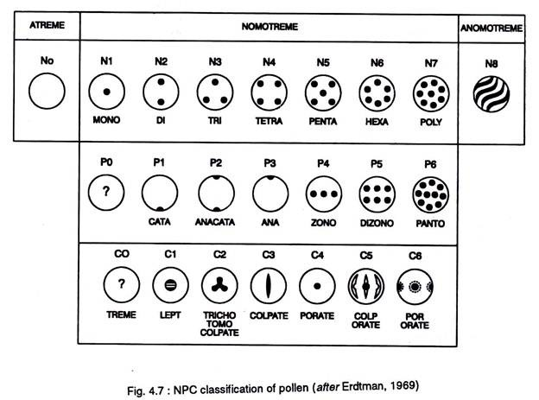
Apertures
Morphologically aperture is an opening or thinning of exine. Physiologically a germination zone or a harmomegathus.
1. NPC Classification: Pollen were classified based on the apertures, their Number( N – whether single or two or many), Position (P- polar,distal or proximal, global or meridional), Characters( C –circular or elongated).
Fig 6

Slide 14
Based on number-
Atreme , Monotreme , Ditreme , Tritreme, Tetratreme ,Pentatreme , Hexatreme, Polytreme ,Anomotreme.
Based on Position-
Catatreme, Anatreme , Anacatatreme ,Zonotreme ,Dizonotreme ,Pantotreme.
Based on characters-
Leptoma , Trichotomocolpate , Colpate, Porate, Colporate ,Poroporate.
2.Apertural types: are of two basic types, namely
a) Simple aperture- with one aperture.
b) Compound aperture- with two different apertures.
Simple aperture includes-
Lete- Psilotum , Lycopodium.
Porus- Urticaceae , Ulmaceae.
Periporus- Amaranthaceae, Malvaceae.

Slide 15
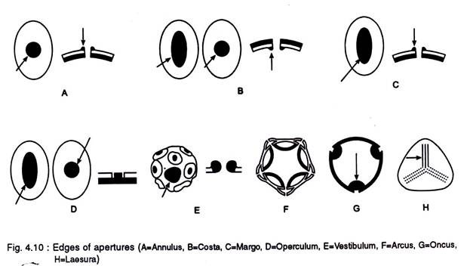
Ulcus – Poacea
Sulcus – Arecaceae , Magnoliaceae.
Sulculi – Eupomatia , Atherosperma.
Colpus – Lamiaceae, Brassicaceae.
Pericolpus – Portulacaceae, Martyniaceae.
Compound apertures includes-
Colporus, Pericolporus , Pororus .
3.Edges of apertures-
Annulus , Costa ,Margo , Operculum , Vestibulum ,Arcus, Oncus , Laesura .
Fig 7

Slide 16
Sporoderm stratification
The pollen wall, the sporoderm is stratified.
The walls consists of two layers- intine and an outer acetolylis resistant layer called exine , composed of sporopollenin.
Exine is divided into sexine and nexine.
Sexine again composed of two layers- ectosexine and endosexine.
Nexine – nexine 1 and nexine 2 ( Erdtman).
Knut Faegri(1964) recognized two layers of exine-the outer ektexine ( sexine and nexine 1) and inner endexine.(nexine 2).

Slide 17
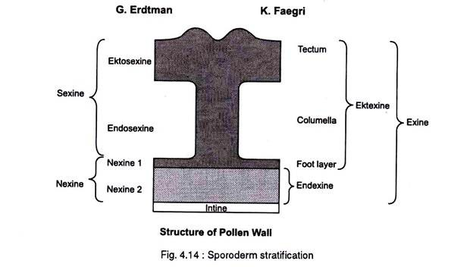
FIG 8

Slide 18
Exine Ornamentation
The are two types of exine ornamentation, the structure or texture and the sculpturing.
Supratectal sculpturing
There are several external textural modifications of the exine of pollen grains.It is an usual feature of ektexine.Tectum may be psilate with forming structures like spinules, spines , pila, verruca ,gemma , clava, granules, etc.
Sculpturing on subtectate sexine
In subtectate or semitectate grains the tectum is provided with minute perforations and surface ornamentations namely- foveolate, rugulate, fossulate,striato-reticulate,etc.

Slide 19
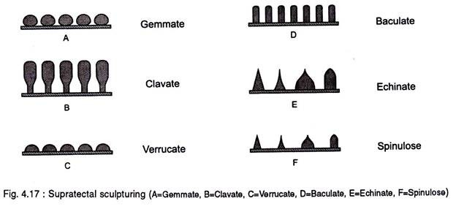
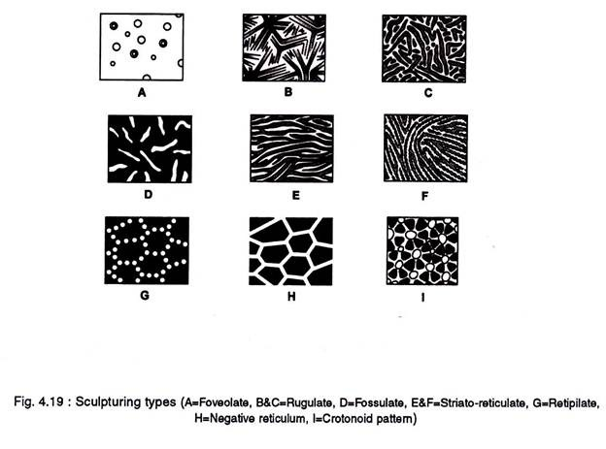

Slide 20
Conclusion
The morphological characteristics of the pollen grains are manifestated in the outermost pollen wall ( exine).
The stratification of exine along with number, position and characters have been used to classify pollen grains.
Comparative study of pollen grains is very useful in systematic consideration.These phenomena are the most important criteria for research dealing with both extant and extinct pollen grains.
Pollen and spore morphology deals with borderline fields between palynology and taxonomy, cytology, genetics and other related fields.

Slide 21
References
Palynology.
Pollen Morphology. Dr. Matt Smith $ Prof Carmen Galan.
Palynology . Mohamed K Zobaa.
http://www.wikipedia.org

Slide 22


