Slide 1
Consideration
Rashmita borgohain
Dept of Commerce

Slide 2
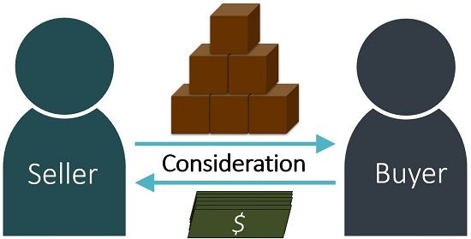
Concept
Consideration is the foundation of every contract
Law enforces only those promises which are made for consideration
When one party promises to do something, it must get something in return
This something in return is consideration

Slide 3
definition
Section 2 (9) of the Indian contract act defines consideration as-
When at the desire of the promisor,
The promisee or any other person,
Has done or abstained from doing, or does or abstains from doing, or promises to do or abstain from doing,
Something, such act or abstinence or promise is called a consideration for the promise
According to pollock “ consideration is the price for which the promise of other is bought and the promiser thus given for value is enforceable.”

Slide 4
Essentials of a valid consideration
It must move at the desire of the promisor
It must move from the promisee or any other person
Consideration may be past, present or future
It need not be adequate
It must be real
It must be lawful

Slide 5

Importance of consideration
Consideration is the foundation of every contract.
The law insists on the existence of consideration if promise is to be enforced as creating legal obligations.
A promise without consideration is null and void.

Slide 6

No consideration no contract- exception
Natural love and affection
Compensation for services rendered
Time-barred debt
Completed gifts
Agency
Guarantee
remission

Slide 7


