Slide 1

Recruitment and selection
Rashmita Borgohain
S B Deorah College
Dept of Commerce

Slide 2
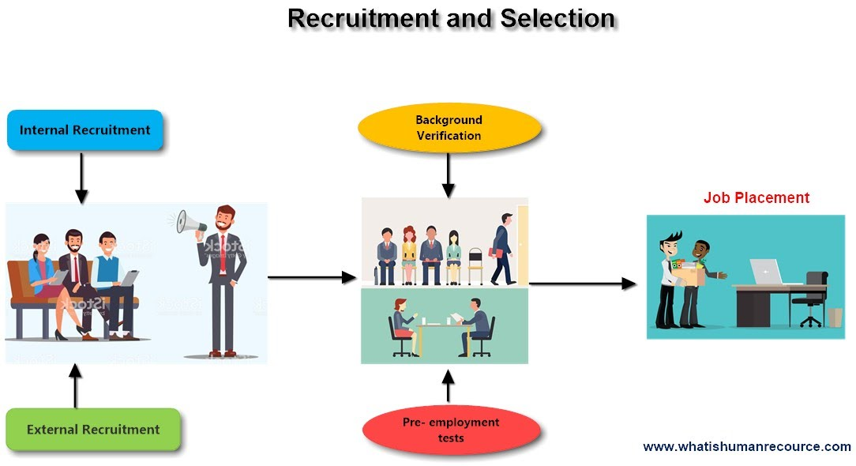

Slide 3
meaning of recruitment
Recruitment is a positive process of searching for prospective employees and stimulating them to apply for the jobs in the organization. When more persons apply for jobs then there will be a scope for recruiting better persons.
Recruitment is a linkage activity bringing together those with jobs and those seeking jobs.
The term recruitment refers to discovering the source from where potential employees may be selected.
The scientific recruitment process leads to higher productivity, better wages, high morale, reduction in labour turnover and enhanced reputation.
It stimulates people to apply for jobs; hence it is a positive process.

Slide 4
definition
According to Edwin B. Flippo, “It is a process of searching for prospective employees and stimulating and encouraging them to apply for jobs in an organization.”
According to Dale Yoder, "Recruitment is a process to discover the sources of manpower to meet the requirements of the staffing schedule and to employ effective measures for attracting that manpower in adequate numbers to facilitate effective selection of an efficient working force”

Slide 5
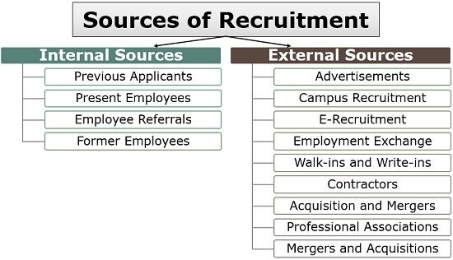

Slide 6
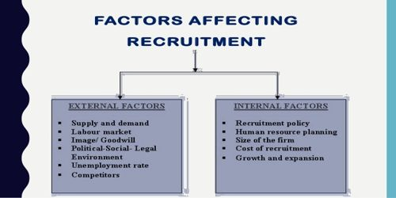

Slide 7
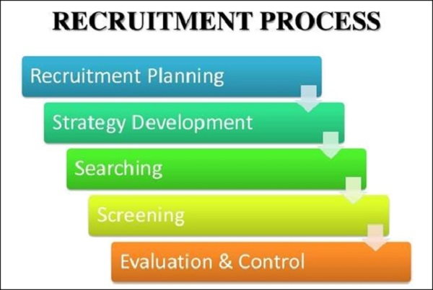

Slide 8
Recruitment Planning
Recruitment planning is the first step of the recruitment process, where the vacant positions are analyzed and described. It includes job specifications and its nature, experience, qualifications and skills required for the job, etc.
structured recruitment plan is mandatory to attract potential candidates from a pool of candidates. The potential candidates should be qualified, experienced with a capability to take the responsibilities required to achieve the objectives of the organization.
Identifying Vacancy
The first and foremost process of recruitment plan is identifying the vacancy. This process begins with receiving the requisition for recruitments from different department of the organization to the HR Department, which contains −
Number of posts to be filled
Number of positions
Duties and responsibilities to be performed
Qualification and experience required

Slide 9
Job Analysis
Job analysis is a process of identifying, analyzing, and determining the duties, responsibilities, skills, abilities, and work environment of a specific job. These factors help in identifying what a job demands and what an employee must possess in performing a job productively.
The following steps are important in analyzing a job −
Recording and collecting job information
Accuracy in checking the job information
Generating job description based on the information
Determining the skills, knowledge and skills, which are required for the job
The immediate products of job analysis are job descriptions and job specifications.

Slide 10
Recruitment Strategy
Recruitment strategy is the second step of the recruitment process, where a strategy is prepared for hiring the resources. After completing the preparation of job descriptions and job specifications, the next step is to decide which strategy to adopt for recruiting the potential candidates for the organization.
While preparing a recruitment strategy, the following points −
Make or buy employees
Types of recruitment
Geographical area
Recruitment sources

Slide 11
Advantages of Selection
A good selection process offers the following advantages−
It is cost-effective and reduces a lot of time and effort.
It helps avoid any biasing while recruiting the right candidate.
It helps eliminate the candidates who are lacking in knowledge, ability, and proficiency.
It provides a guideline to evaluate the candidates further through strict verification and reference-checking.
It helps in comparing the different candidates in terms of their capabilities, knowledge, skills, experience, work attitude, etc.
A good selection process helps in selecting the best candidate for the requirement of a vacant position in an organization.

Slide 12
Searching the Right Candidates
Searching is the process of recruitment where the resources are sourced depending upon the requirement of the job. After the recruitment strategy is done, the searching of candidates will be initialized.
This process consists of two steps −
Source activation − Once the line manager verifies and permits the existence of the vacancy, the search for candidates starts.
Selling − Here, the organization selects the media through which the communication of vacancies reaches the prospective candidates.
Searching involves attracting the job seekers to the vacancies. The sources are broadly divided into two categories: Internal Sources and External Sources.
Screening / Shortlisting
Screening starts after completion of the process of sourcing the candidates. Screening is the process of filtering the applications of the candidates for further selection process.
Screening is an integral part of recruitment process that helps in removing unqualified or irrelevant candidates, which were received through sourcing.

Slide 13
Evaluation and Control
Evaluation and control is the last stage in the process of recruitment. In this process, the effectiveness and the validity of the process and methods are assessed. Recruitment is a costly process, hence it is important that the performance of the recruitment process is thoroughly evaluated.
The costs incurred in the recruitment process are to be evaluated and controlled effectively. These include the following −
Salaries to the Recruiters
Advertisements cost and other costs incurred in recruitment methods, i.e., agency fees.
Administrative expenses and Recruitment overheads
Overtime and Outstanding costs, while the vacancies remain unfilled
Cost incurred in recruiting suitable candidates for the final selection process
Time spent by the Management and the Professionals in preparing job description, job specifications, and conducting interviews.

Slide 14
SELECTION
Selection is a process of putting a right applicant on a right job.
Selection of an employee is a process of choosing the applicants, who have the qualifications to fill the vacant job in an organization.
Selection is a process of identifying and hiring the applicants for filling the vacancies in an organization.
Employee selection is a process of matching organization’s requirements with the skills and the qualifications of individuals.
A good selection process will ensure that the organization gets the right set of employees with the right attitude.

Slide 15
Difference between recruitment and selection
Recruitment | Selection
Recruitment is defined as the process of identifying and making the potential candidates to apply for the jobs. | Selection is defined as the process of choosing the right candidates for the vacant positions.
Recruitment is called as a positive process with its approach of attracting as many candidates as possible for the vacant jobs | Selection is called as a negative process with its elimination or rejection of as many candidates as possible for identifying the right candidate for the position.

Slide 16
Importance of Selection
Selection is an important process because hiring good resources can help increase the overall performance of the organization. In contrast, if there is bad hire with a bad selection process, then the work will be affected and the cost incurred for replacing that bad resource will be high.
The purpose of selection is to choose the most suitable candidate, who can meet the requirements of the jobs in an organization, who will be a successful applicant.
For meeting the goals of the organization, it is important to evaluate various attributes of each candidate such as their qualifications, skills, experiences, overall attitude, etc. In this process, the most suitable candidate is picked after the elimination of the candidates, who are not suitable for the vacant job.
The organization has to follow a proper selection process or procedure, as a huge amount of money is spent for hiring a right candidate for a position.
If a selection is wrong, then the cost incurred in induction and training the wrong candidate will be a huge loss to the employer in terms of money, effort, and also time

Slide 17
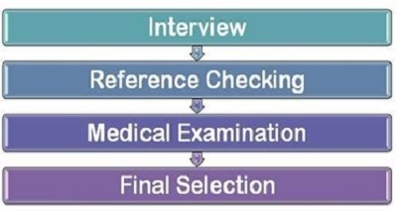
Selection Process and Steps

Slide 18
Employment Interview − Employment interview is a process in which one-on-one session in conducted with the applicant to know a candidate better. It helps the interviewer to discover the inner qualities of the applicant and helps in taking a right decision.
Checking References − Reference checking is a process of verifying the applicant’s qualifications and experiences with the references provided by him. These reference checks help the interviewer understand the conduct, the attitude, and the behavior of the candidate as an individual and also as a professional.
Medical Examination − Medical examination is a process, in which the physical and the mental fitness of the applicants are checked to ensure that the candidates are capable of performing a job or not. This examination helps the organization in choosing the right candidates who are physically and mentally fit.
Final Selection − The final selection is the final process which proves that the applicant has qualified in all the rounds of the selection process and will be issued an appointment letter.
A selection process with the above steps will help any organization in choosing and selecting the right candidates for the right job.

Slide 19


